Slide 1
Technical Communication Editing Lecture Session - 7

Slide 2
INTRODUCTION
Technical editing involves reviewing text written on a technical topic, and identifying errors related to the use of language in general or adherence to a specific style guide.
This activity ensures that documentation is of good quality.
Technical style favors simplicity and conciseness in sentence structure, specificity in usage of words, streamlined and clear organization of content and heavy reliance on graphics.
Also, technical documents often follow a specific format, which has to be followed throughout.

Slide 3
Types of Editing
Editing also involves changing the text according to the subject, audience and purpose.
As a novice, you could start editing the material to suit the subject audience and the purpose of writing the technical document.
Finally, look for the phrasing, grammar, and punctuation. This kind of editing is broadly classified as Macro editing and Micro editing.

Slide 4
Macro Editing
Main issues such as :
clear matter or purpose statements
easy-to-follow organization of the content
a thorough summary and introduction
accurate as well as complete content are favored in macro editing.

Slide 5
be familiar with the type of document
its subject matter
the company producing the document in order to edit the document effectively at a macro level.
To check the content of the material, how it has been organized and its logic to ensure that it addresses its subject and audience, thereby serving the purpose for which it is written.

Slide 6
Micro editing
It is also called copy editing or line editing.
This involves necessary revisions to individual sentences or graphics.
It is the close editing of the text.
In other words, here the editing is done word by word and line by line to come out with a well written document that is sound in expression, correct in grammar, consistent with company standards.

Slide 7
The editor checks the complexity level to make sure that the text in the document is presented at an appropriate level to match the complexity level of the readers.
The editor also has to check for the correctness; he has to fine tune the document to ensure its consistency with standards and correctness in sentence structure, grammar, spelling and punctuation.

Slide 8
Roles of Technical Editor
Improving text material:
The editor determines how appropriate the content and organization are for the purpose and audience.
He is instrumental in making the verbose material into concise and clear.
In doing this he should be cautious because he needs to retain the tone and words used by the writer.

Slide 9
Examining the graphics for appropriateness and balance:
He also helps in the task of selecting, naming and numbering of graphics as well as placing them in suitable context.
Identifying sections that need fuller development:
Check each section for logic and completeness of evidence to support claims. Correcting errors, if any, of spelling, grammar, and style.

Slide 10
EDITING TASK (procedure)
When the editor receives the technical document as a preliminary draft, he has to first review the document for the appropriateness of content.
He also checks if the draft is organized in a logical manner. The document need not be accurately polished at this stage because at the time of each editing, the material undergoes a radical revision.

Slide 11
The technical editor makes sure that the sections framed in the material match the number of sections that were planned in the document outline.
He/She has to also ensure that the illustrations or graphics printed are placed in the proper sections of the text.
The editor needs to read each section for the content. If he finds it necessary he may also add sentences to clarify the organization of each section in order to recheck if the sections are placed in a proper order

Slide 12
Proof Reading
Careful proof reading can ensure that a printed document is correct and attractive and that the document creates a good impression of the company that produced it.
Proof readers should concentrate on main regions such as:
i) Content – To effectively proof read a technical document, you should check the technical details against a reliable reference. You should also pay attention to the inconsistencies in data and look out for mistakes in labeling units of measures, Greek letters, formulas and mathematical symbols.

Slide 13
ii) Spelling – Misspellings are the most obvious errors to readers of published documents, so proofreaders should check carefully for accuracy of spelling. It is not wise to rely on spelling checkers in word processing programs, which will only flag words not in their own dictionary. Most spelling checkers do not recognize correct words used improperly, like ‘here’ and ‘hear’, ‘form’ and ‘from’, so proof readers should check each word for context as well as spelling.
iii) Others – Grammar errors should be checked. There should be consistency in the language used, whether it is American English or British English. Special care should be taken while checking the usage of Proper nouns. Any misspellings in names of products or people could lead to a lot of embarrassment. The accuracy of titles, headings and illustration captions should be checked very carefully.

Slide 14
PROOF READING SYMBOLS
Editing and proof reading symbols are universal regardless of subject matter.
Editing symbols are used on hard copy to indicate to a typist, type setter or graphic artist the changes the editor wants made when the text of a document is typed for the first time in a soft copy, when the soft copy version of text is revised, and when graphics are created or revised.

Slide 15
The symbols that you use to indicate corrections or changes in the text are called ‘Proof reading symbols.’
If you change the symbols time and again, it leads to inconsistency and may confuse the typist or writer when he/she intends to do the changes suggested by you as an editor.
The purpose of proofreading is to find the typographical errors.
The proof reading symbols are usually placed in the margins of the text, with a line drawn to indicate the exact place of the error.
You can choose the margin depending on the place of error. If the error is closer towards the right margin, indicate the proof reading symbol in the right margin. The symbol is placed in the left margin, if the error is towards it.

Slide 16
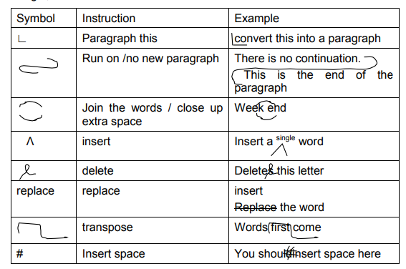

Slide 17
